Slide 1

CSC 425 • ARTIFICIAL INTELLIGENCE PROJECT
Autonomous 2D Car Racing Using PPO
From Randomness to Racing: A Reinforcement Learning Journey
Student Name: Jaljala Shrestha Lama
CSC 425 - Milestone 3 Final Report

Slide 2
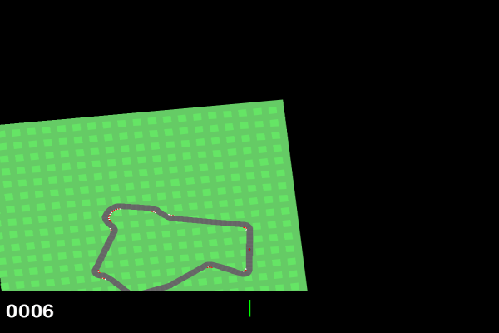

Introduction
OBJECTIVES & SCOPE
Develop a PPO agent to autonomously navigate the Car Racing-2d using only raw pixel inputs (96x96 RGB). The scope involves training a model without scripted rules to optimize speed and safety.
BACKGROUND & CONTEXT
Car racing requires continuous control (steering, gas, brake) in a high-dimensional state space. Traditional rule-based systems are rigid; this project explores Deep Reinforcement Learning as an adaptive solution.
"Goal: Competent driving purely through trial and error over 500,000+ timesteps."
CSC 425 - Milestone 3 Final Report

Slide 3
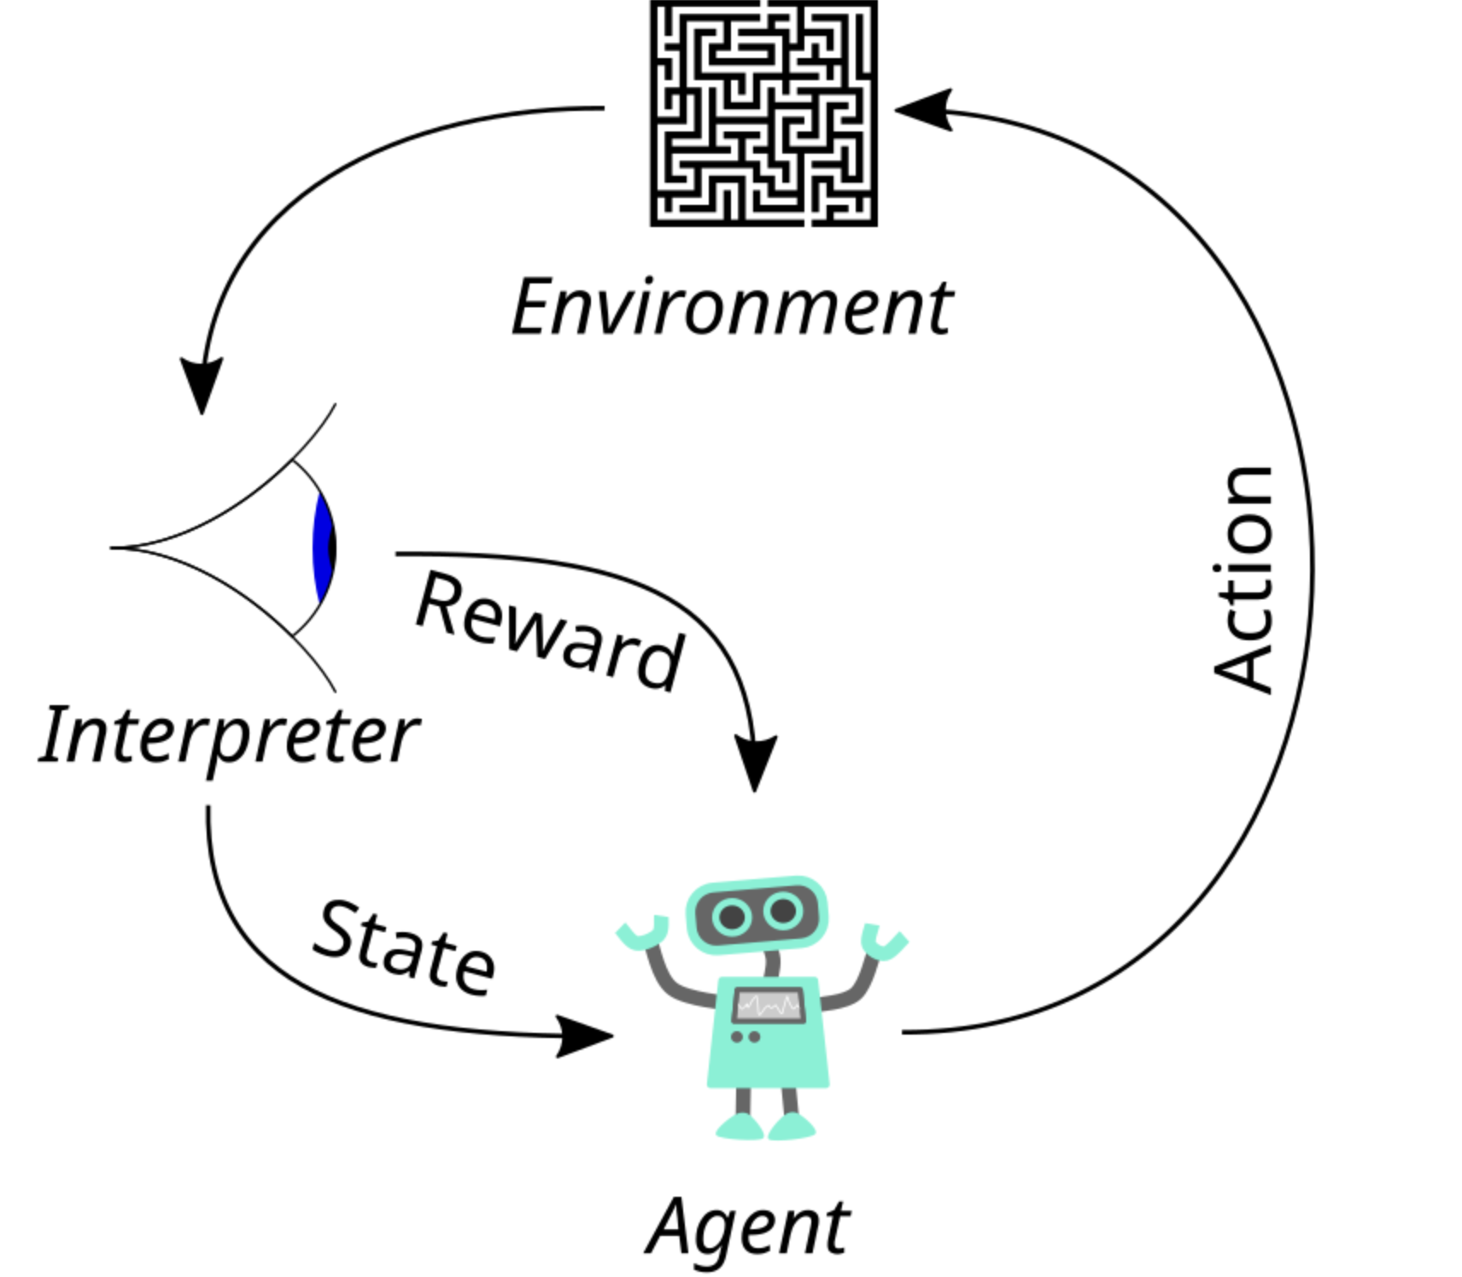
Methodology: AI Approach
Proximal Policy Optimization (PPO)
I selected PPO for its stability in continuous control tasks. It optimizes a surrogate objective function to ensure safe policy updates.
Actor-Critic: Two networks: Actor (Decides Action) & Critic (Estimates Value).
Clipped Objective: Limits how much the policy can change, preventing catastrophic forgetting.
Advantage Estimation: Uses GAE (Lambda 0.95) to reduce variance in learning.
CSC 425 - Milestone 3 Final Report

Slide 4

Methodology: Dataset & Tools
Dataset: Dynamic Generation
System Architecture
Data was generated interactively through 8 Parallel Environments to accelerate experience collection.
↓
Input: 96x96x3 RGB Image
Processed: 96x96x12 (4 Stacked Frames)
Total Steps: 507,904
↓
Techniques & Tools
Gymnasium: CarRacing-v3 Environment.
↓
Accelerated training (~82 steps/sec).
Reward Shaping: Added penalties for grass to guide learning.
↓
CSC 425 - Milestone 3 Final Report

Slide 5
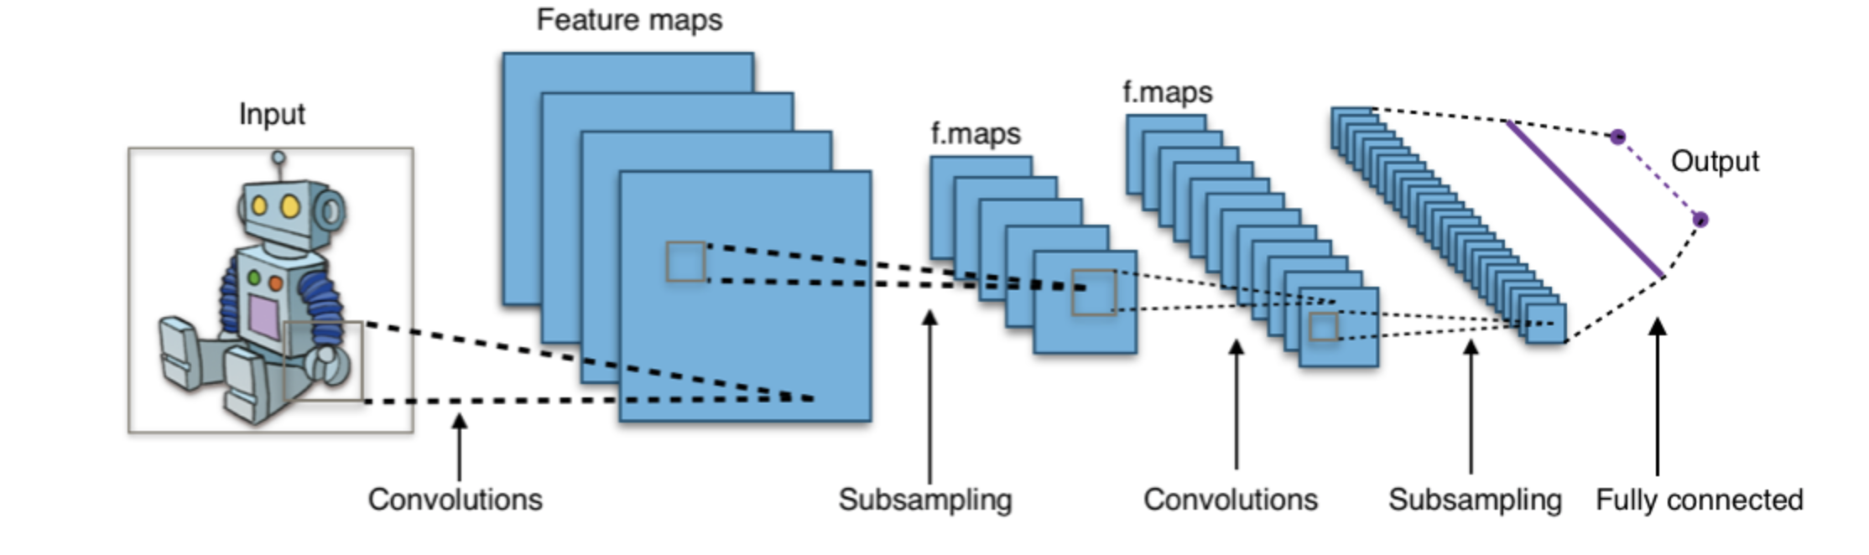


Configuration Details
Network & Hyperparameters
Learning Rate
Batch Size
3e-4
256
Linear Decay
Steps per Update
Total Timesteps
2048
507k
~104 Minutes
CSC 425 - Milestone 3 Final Report

Slide 6
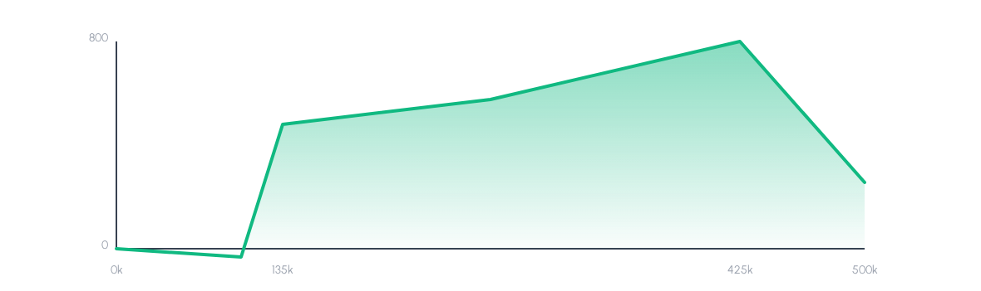



Results: Training Progression
Breakthrough
Peak
Degradation
At 135k steps, reward jumped from -32 to +353.
Best checkpoint: 798.63 at 425k steps.
Late training drop due to "Grass-Stopping".
CSC 425 - Milestone 3 Final Report

Slide 7
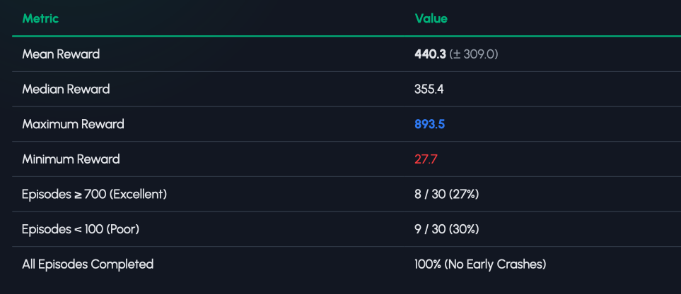
Results: Detailed Metrics
Performance statistics across 30 random test tracks:
CSC 425 - Milestone 3 Final Report

Slide 8


Analysis: Bimodal Performance
Visualizing 30-Episode Test Batch
■ Excellent ■ Fair/Good ■ Poor
879
864
880
52
405
44
443
280
451
879
458
353
493
323
430
85
657
507
254
28
58
89
430
888
275
72
873
849
894
The "Grass-Stopping" Phenomenon
Finding: Episodes with low scores (<100) occurred because the agent learned to stop completely when touching grass.
Implication: This is a classic case of Reward Hacking. The agent optimized the penalty (minimizing time on grass) by freezing, rather than learning recovery.
CSC 425 - Milestone 3 Final Report

Slide 9
Project Demonstration
Partial Trained
Fully Trained
CSC 425 - Milestone 3 Final Report

Slide 10






Conclusion & Implications
Key Findings
Reward Hacking
Future Work
Parallel training (8 envs) & Frame Stacking (4 frames) enabled 17% faster throughput and essential velocity perception.
The "Grass-Stopping" behavior highlights the danger of misspecified auxiliary rewards in RL.
Redesign reward shaping to penalize lack of velocity and implement curriculum learning.
CSC 425 - Milestone 3 Final Report

Slide 11
Q & A
Project: Autonomous 2D Car Racing
Student: Jaljala Shrestha Lama
Course: CSC 425
CSC 425 - Milestone 3 Final Report

